Slide 1
E-MOVIE TICKETS

Slide 2
OBJECTIVE:
E-Movie Tickets provides the solution booking tickets from their home or office and view the more details on movies.

Slide 3
EXISTING SYSTEM:
Existing system has no facility to booking the tickets from their home or office.
Existing system does not provide the easy retrieval of movies information.

Slide 4
PROPOSED SYSTEM:
The development of this new system contains the following
activities, which try to recover the problems from the previous
system:
Secure registration and profile management facilities for system users
Tracking member’s activities and progress.
Facilitating communication – Through Emails among System users.
Basic and advance admin facilities like add/update members, backup/recovery of data, generating various reports etc.
Provide the solution for booking requests.

Slide 5
NUMBER OF MODULES:
The system after careful analysis has been identified to be presented with the following modules:
The Modules involved are
Admin
Agent
Customer
Security and Authentication
Reports

Slide 6
ADMIN MODULE:
Admin registers agents’ info and views the agent details.
Registers the movies and view the movie details.
Register the theatres and give the details about theatre dealing movies information.
View the customer requests and give the status for allowing to the system.
Provide the status of movie ticket booking requests.
Provides the news information and also provides event details.

Slide 7
AGENT MODULE:
View the movie details
View his/her personal profile
Search the movies information by theatre wise.
Make the request for movie ticket booking.
View the status of movie ticket bookings.

Slide 8
CUSTOMER MODULE:
View the movie details
View his/her personal profile
Search the movies information by theatre wise.
Make the request for movie ticket booking.
View the status of movie ticket bookings.

Slide 9
SECURITY AND AUTHENTICATION :
User Registration.
Login as Agent and Administrator and Customer.
Change password
Forgot Password

Slide 10
REPORTS:
In this Module the administrator, dealer can generate different types of reports.

Slide 11
SOFTWARE REQUIREMENTS :
Operating System : Windows XP/2003 or Linux
User Interface : HTML, CSS
Client-side Scripting : JavaScript
Programming Language : Java
Web Applications : JDBC, Servlets, JSP
IDE/Workbench : My Eclipse 6.0
Database : Oracle 10g
Server Deployment : Tomcat 5.x

Slide 12
HARDWARE REQUIREMENTS
Processor : Core 2 Duo
Hard Disk : 160GB
RAM : 1GB or more

Slide 13
SYSTEM REQUIREMENT SPECIFICATION

Slide 14
Study of the System:
In the flexibility of uses the interface has been developed a graphics concepts in mind, associated through a browser Interface. The GUI’s at the top level has been categorized as follows
Admin
Agent
Customer
Number of Modules:
The system after careful analysis has been identified to be presented with the following modules:
The Modules involved are..
Admin
Agent
Customer
Security and Authentication
Reports

Slide 15
Admin Module:
Admin registers agent’s info and views the agent details.
Registers the movies and view the movie details.
Register the theatres and give the details about theatre dealing movies information.
View the customer requests and give the status for allowing to the system.
Provide the status of movie ticket booking requests.
Provides the news information and also provides event details.
Agent Module:
View the movie details
View his/her personal profile
Search the movies information by theatre wise.
Make the request for movie ticket booking.
View the status of movie ticket bookings.

Slide 16
Customer Module:
View the movie details
View his/her personal profile
Search the movies information by theatre wise.
Make the request for movie ticket booking.
View the status of movie ticket bookings.
Security and Authentication:
User Registration.
Login as Agent and Administrator and Customer.
Change password
Forgot Password
Reports:
In this Module the administrator, dealer can generate different types of reports.

Slide 17
FEASIBILITY STUDY

Slide 18
TECHNICAL FEASIBILITY:
Evaluating the technical feasibility is the trickiest part of a feasibility study. This is because, at this point in time, not too many detailed design of the system, making it difficult to access issues like performance, costs on (on account of the kind of technology to be deployed) etc. A number of issues have to be considered while doing a technical analysis.
Understand the different technologies involved in the proposed system
Find out whether the organization currently possesses the required technologies
Operational Feasibility:
Proposed project is beneficial only if it can be turned into information systems that will meet the organizations operating requirements. Simply stated, this test of feasibility asks if the system will work when it is developed and installed. Are there major barriers to Implementation? Here are questions that will help test the operational feasibility of a project:Is there sufficient support for the project from management from users? If the current system is well liked and used to the extent that persons will not be able to see reasons for change, there may be resistance.

Slide 19
Economic Feasibility:
Economic feasibility attempts 2 weigh the costs of developing and implementing a new system, against the benefits that would accrue from having the new system in place. This feasibility study gives the top management the economic justification for the new system.

Slide 20
DATA FLOW DIAGRAMS

Slide 21
A graphical tool used to describe and analyze the moment of data through a system manual or automated including the process, stores of data, and delays in the system. Data Flow Diagrams are the central tool and the basis from which other components are developed. The transformation of data from input to output, through processes, may be described logically and independently of the physical components associated with the system. The DFD is also know as a data flow graph or a bubble chart.
Dataflow: Data move in a specific direction from an origin to a destination.
Process: People, procedures, or devices that use or produce (Transform) Data. The physical component is not identified.
Source: External sources or destination of data, which may be People, programs, organizations or other entities.
Data Store: Here data are stored or referenced by a process in the System.

Slide 23
Authentication Data Flow Diagram:

Slide 24
SDLC METHODOLOGIES

Slide 25
This document play a vital role in the development of life cycle (SDLC) as it describes the complete requirement of the system. It means for use by developers and will be the basic during testing phase. Any changes made to the requirements in the future will have to go through formal change approval process.
SPIRAL MODEL was defined by Barry Boehm in his 1988 article, “A spiral Model of Software Development and Enhancement. This model was not the first model to discuss iterative development, but it was the first model to explain why the iteration models.
The steps for Spiral Model can be generalized as follows:
The new system requirements are defined in as much details as possible. This usually involves interviewing a number of users representing all the external or internal users and other aspects of the existing system.
A preliminary design is created for the new system.
A first prototype of the new system is constructed from the preliminary design. This is usually a scaled-down system, and represents an approximation of the characteristics of the final product.

Slide 26
A second prototype is evolved by a fourfold procedure:
Evaluating the first prototype in terms of its strengths, weakness, and risks.
Defining the requirements of the second prototype.
Planning an designing the second prototype.
Constructing and testing the second prototype.
Risk factors might involved development cost overruns, operating-cost miscalculation, or any other factor that could, in the customer’s judgment, result in a less-than-satisfactory final product.
The existing prototype is evaluated in the same manner as was the previous prototype, and if necessary, another prototype is developed from it according to the fourfold procedure outlined above.
The preceding steps are iterated until the customer is satisfied that the refined prototype represents the final product desired.
The final system is constructed, based on the refined prototype.
The final system is thoroughly evaluated and tested. Routine maintenance is carried on a continuing basis to prevent large scale failures and to minimize down time.

Slide 27
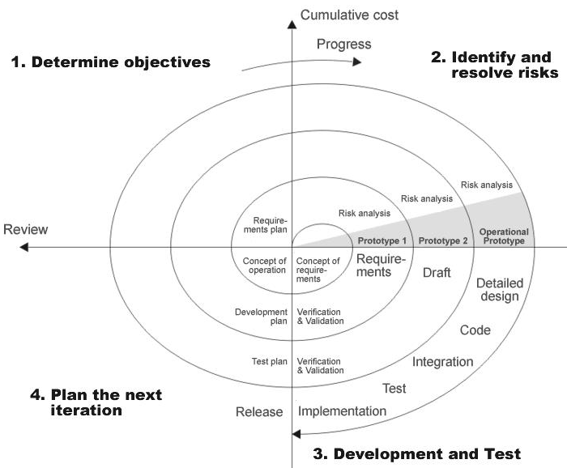
THE FOLLOWING DIAGRAM SHOWS HOW A SPIRAL MODEL ACTS LIKE:

Slide 28
ADVANTAGES OF SPIRAL MODEL:
Estimates(i.e. budget, schedule etc .) become more realistic as work progresses, because important issues discovered earlier.
It is more able to cope with the changes that are software development generally entails.
Software engineers can get their hands in and start working on the core of a project earlier.

Slide 29
E-R DIAGRAM

Slide 30
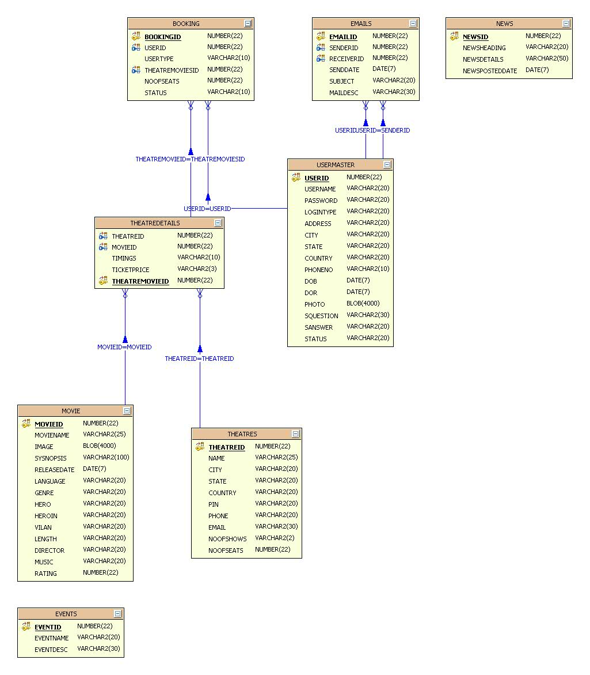

Slide 31
UML DIAGRAMS

Slide 32
The Unified Modeling Language allows the software engineer to express an analysis model using the modeling notation that is governed by a set of syntactic semantic and pragmatic rules.
A UML system is represented using five different views that describe the system from distinctly different perspective. Each view is defined by a set of diagram, which is as follows.
User Model View.
Structural Model View.
Behavioral Model View.
Implement Model View.
Environmental Model View.
UML is specifically constructed through two different domains they are:
UML Analysis modeling, this focuses on the user model and structural model views of the system.
UML design modeling, which focuses on the behavioral modeling, implementation modeling and environmental model views.

Slide 33
CLASS COLLABORATION DIAGRAM

Slide 35
USE CASE DIAGRAMS

Slide 36
System Use Case Diagram:
System
Admin
E-Movie Tickets
Agent
Customer

Slide 37
Admin Use Case Diagram:

Slide 38
Agent Use Case Diagram:

Slide 39
Customer Use Case Diagram:

Slide 40
SEQUENCE DIAGRAMS

Slide 41
Admin:

Slide 42
Agent:

Slide 43
Customer:

Slide 44
COLLABORATION DIAGRAM

Slide 45
Admin:

Slide 46
Agent:

Slide 47
Customer:

Slide 48
ACTIVITY DIAGRAMS

Slide 49
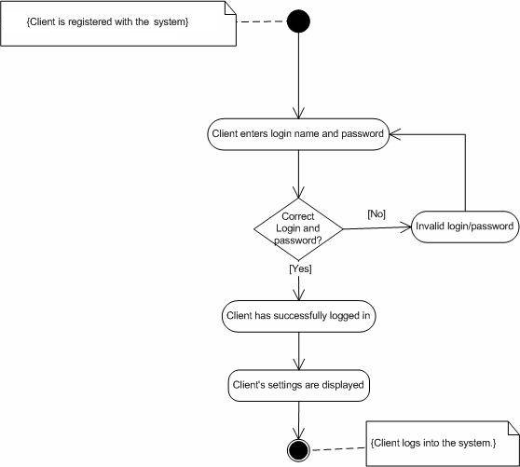

Slide 50
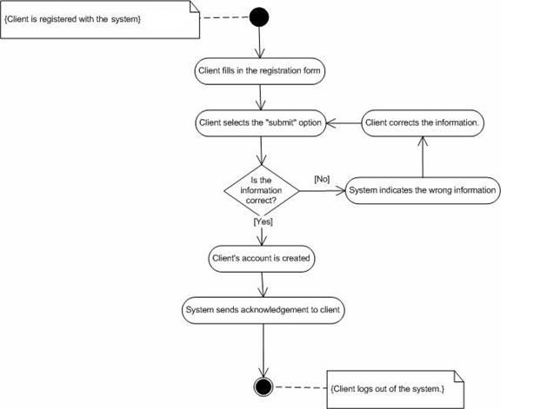

Slide 51
Admin Activity Diagram:

Slide 52
Agent/Customer Activity Diagram:

Slide 53
COMPONENT DIAGRAM

Slide 54
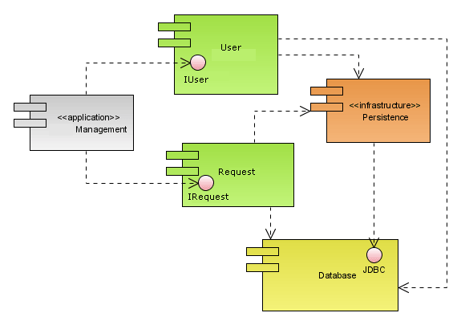

Slide 55
DEPLOYMENT DIAGRAM

Slide 56
